Slide 1
Taiwan Housing Analysis
Presenter: Derick Lai
Date: 06/01/2020

Slide 2
Determining What Affects Housing Price
The following analysis is meant to extrapolate what affects the housing market related to the data from the region it was pulled from.
When plotting for Latitude and Longitude points, our data is derived from a region just below Taipei City, Taiwan
Descriptive statistics were utilized to determine what factors primarily affect the pricing of homes in the region.

Slide 3
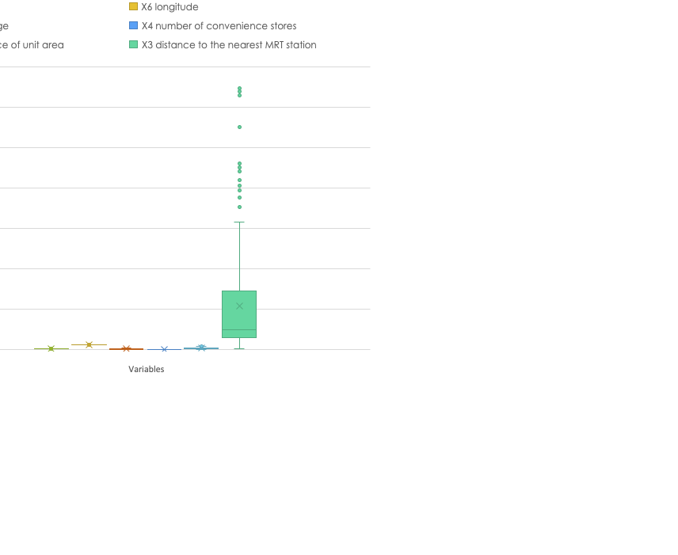
* The data set has offered us several variables to consider when attempting to determine what affects the housing price. *Distance to the nearest MRT Station (Local Transport) offers the widest spread of data between all the variables
There are a number of variables in the dataset to allow us to predict house price per unit area in suburb of Taipei

Slide 4
Distance to nearest MRT station together with Latitude and Longitude and number of convenience stores correlate highly with price / unit area

Slide 5
We see a positive correlation between the # of convenience stores located within the region of the home and House Price. As there are more stores, the House Price is higher.

Slide 6
In regards to House Price and House Age, we see a negative correlation. The older the home, the lower the House Price.

Slide 7
The greatest significance of a relationship is what we see between the House Price and the MRT distance. The further the distance the house is located from local transit, the lower the House Price.

Slide 8
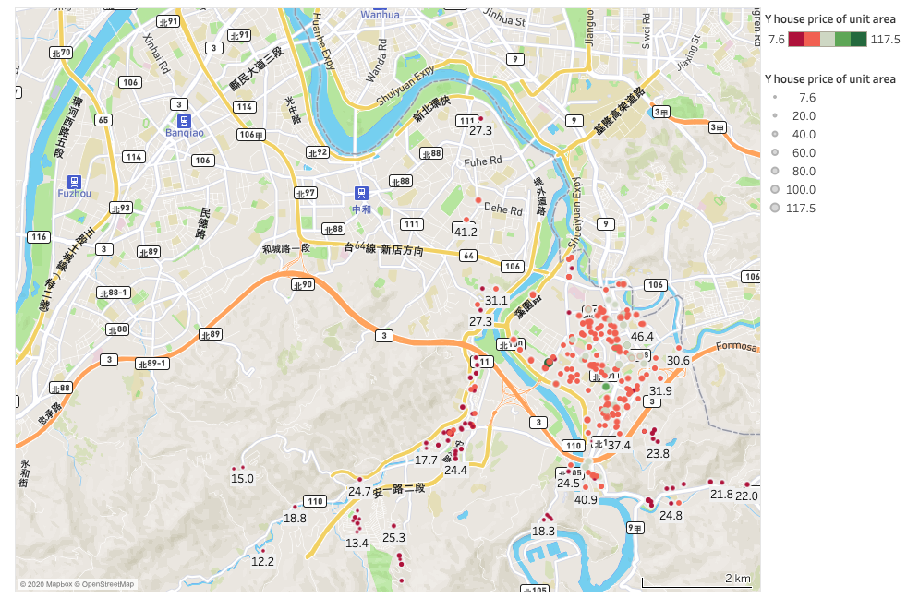
Geo Map displaying the spread of homes and their house prices.

Slide 9
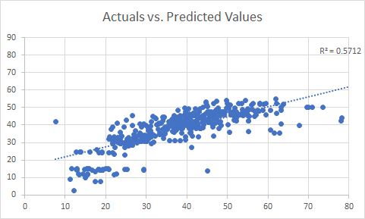
Regression Equation – Detailing the actual and predictive value of House Price

Slide 10
Summary
House Price seems to be most affected by MRT Distance. The closer a home is to a local transit stop, the higher the price of the home.
Older homes look to have lower price values. An analysis on whether a home has been renovated and whether it will affect house pricing would be potential avenue to investigate.
If the home is located closer to more convenience stores, the price of the home is higher. A further analysis should look into what the actual minimum distance requirement was utilized for the original data set, when a home is considered “close” to a convenience store.

Slide 11
Resources
Data Set - https://www.kaggle.com/quantbruce/real-estate-price-prediction

